Slide 1
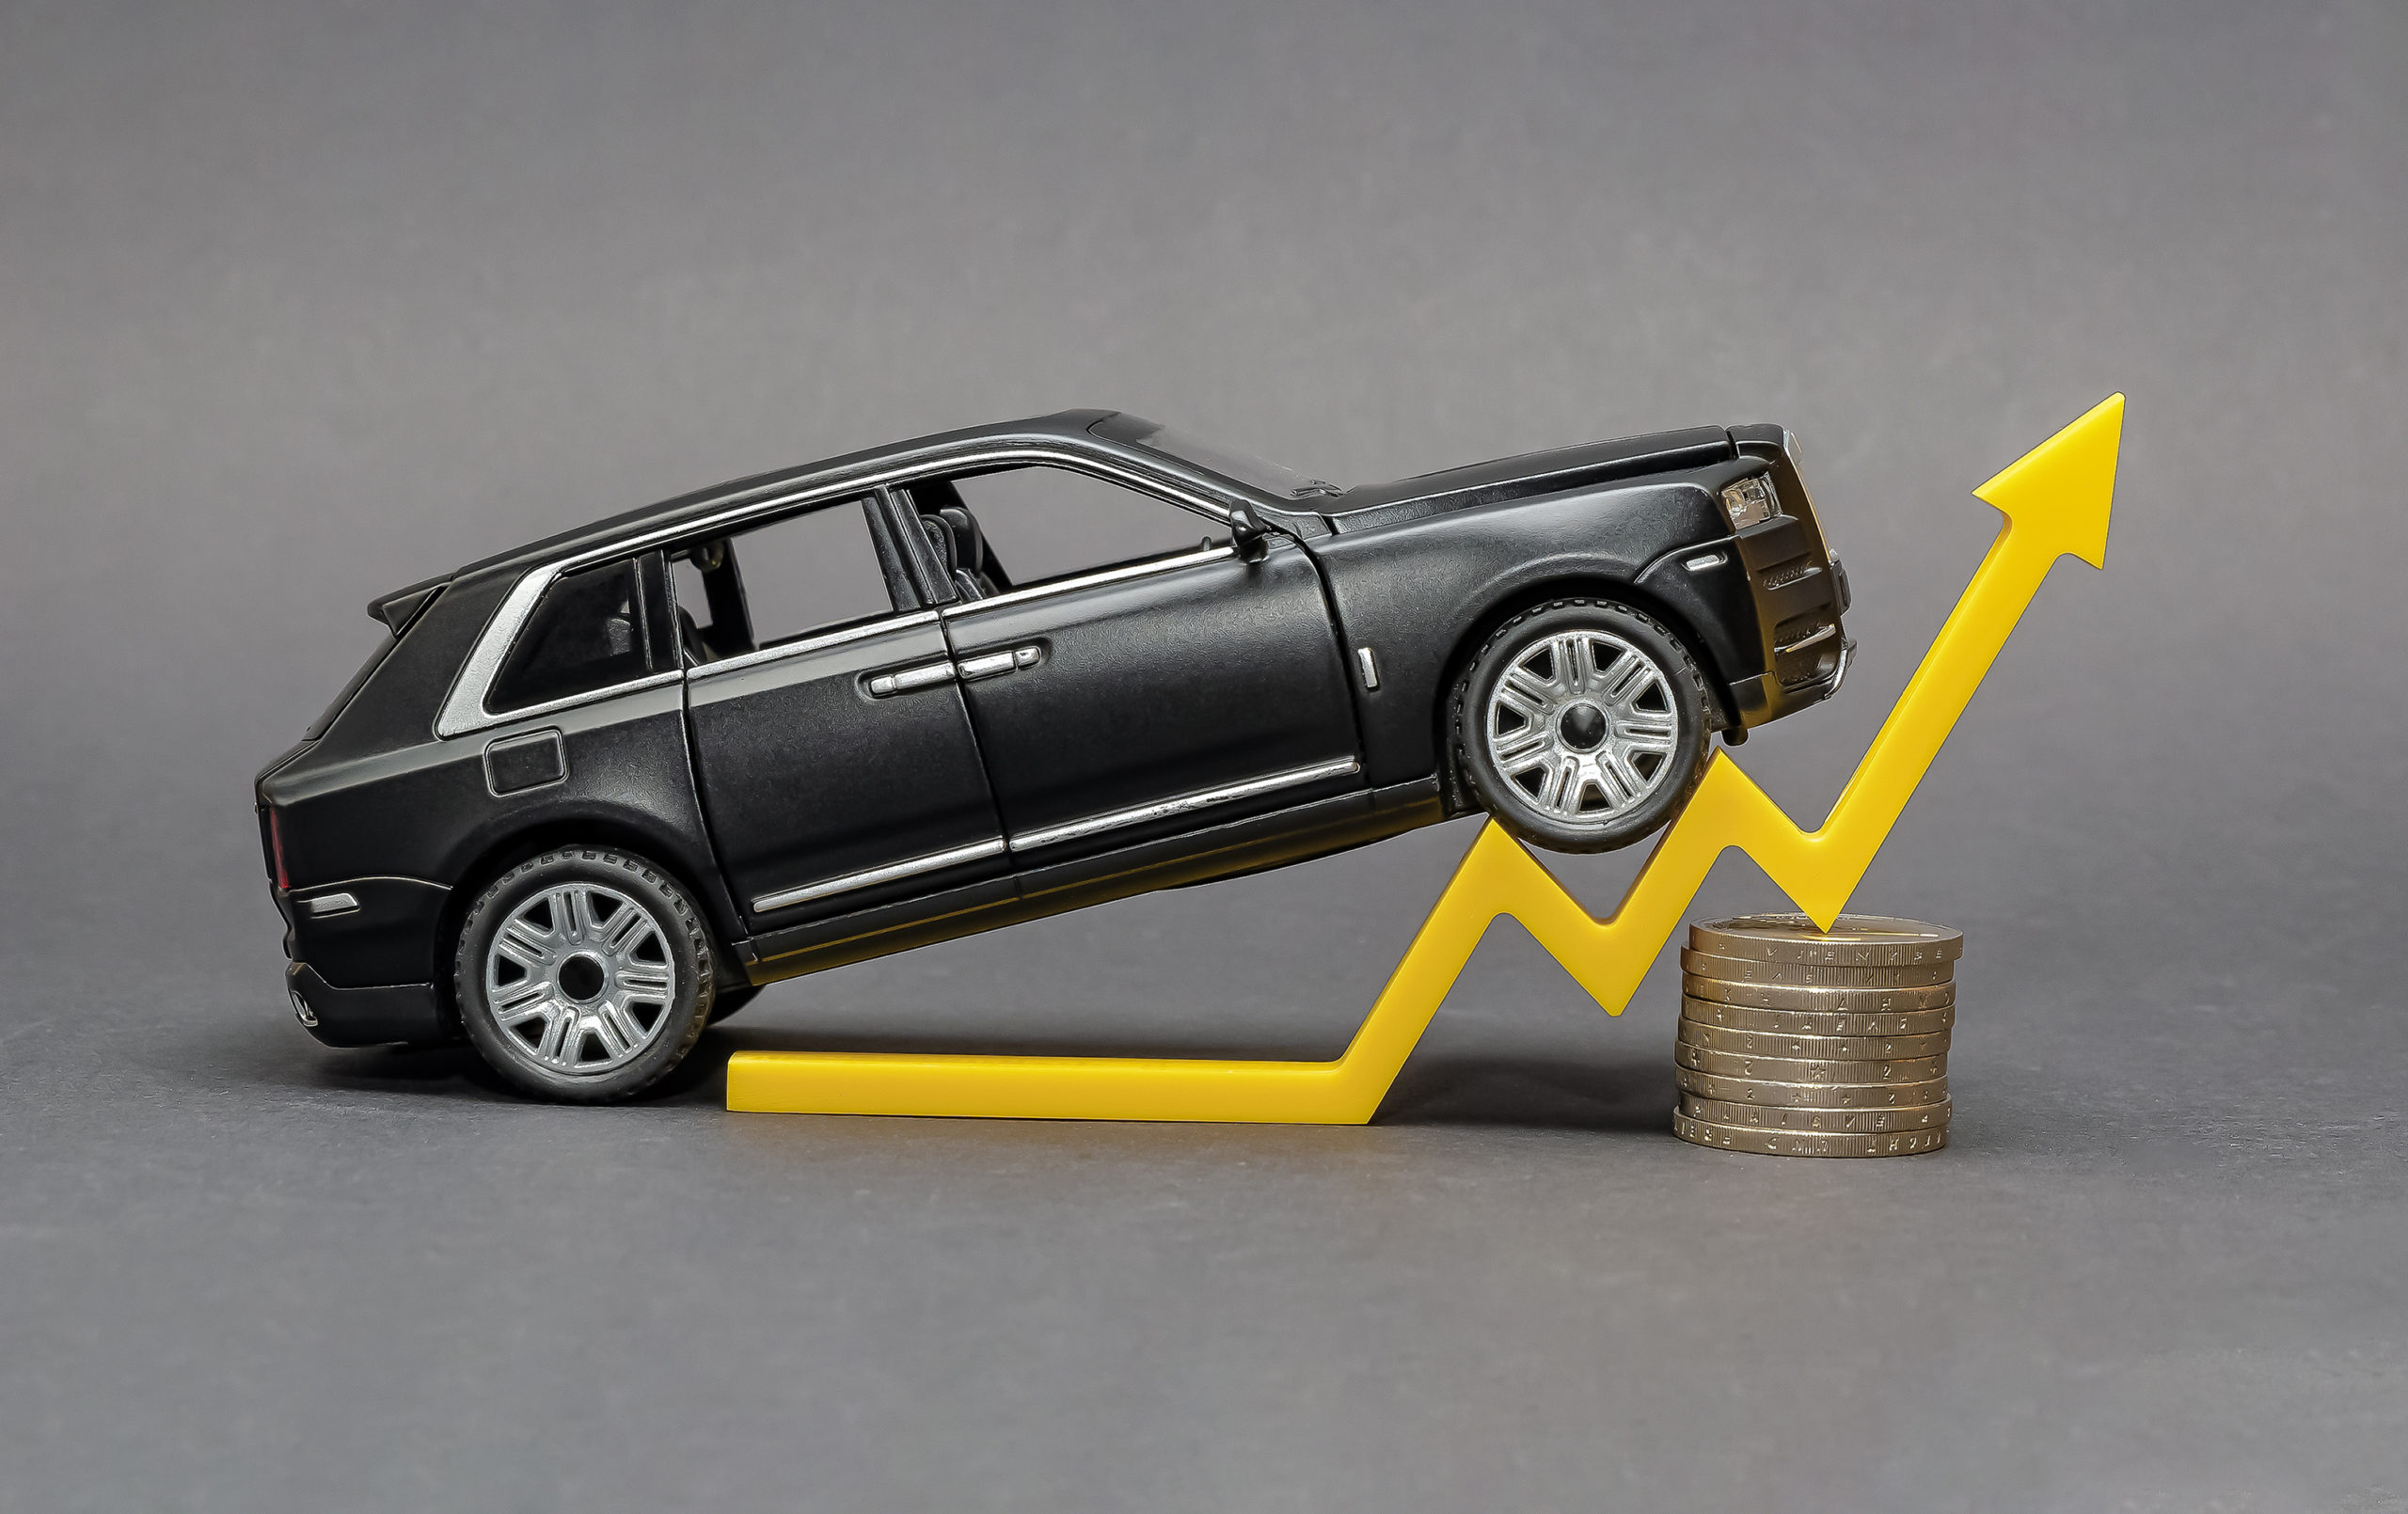
USED CAR PRICE PREDICTION
Agenda:
Introduction
Data Extraction
Data Cleaning
Exploratory Data Analysis
Prediction Modelling
Application Design
Conclusion

Slide 2
Introduction
Objective:
The primary aim of this project is to predict the prices of used cars based on various features such as Type, Mileage, Performance & Features, etc.
Motivation:
The prediction of used car prices is crucial for both buyers and sellers to make informed decisions. It helps sellers set competitive prices and assists buyers in assessing fair value.

Slide 3
Data Extraction
Source:
The dataset was sourced from CSV files containing unstructured data.
Processing:
Utilized Python libraries like pandas to transform raw CSV data into a structured format suitable for analysis.

Slide 4
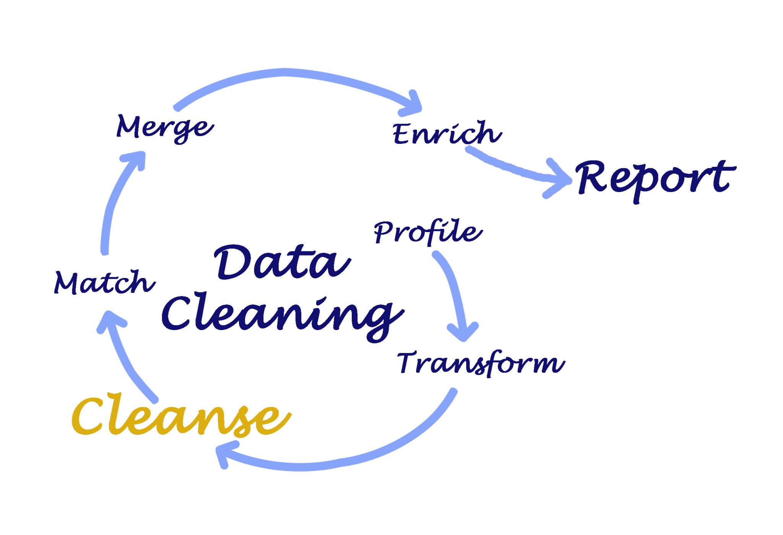
Data Cleaning
Steps Taken:
Handling missing values
Removing duplicates
Standardizing data formats
Addressing outliers
Encoding categorical variables

Slide 5
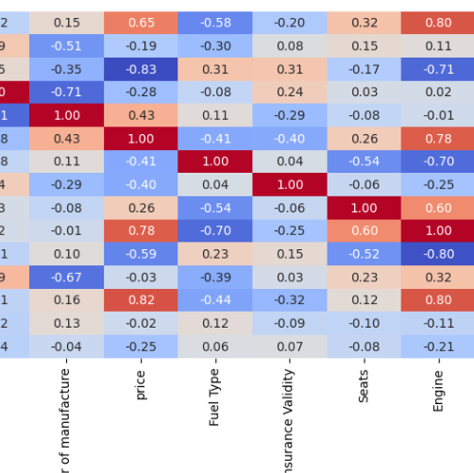
Exploratory Data Analysis
Key Insights:
Statistical summaries of numerical features
Distribution plots
Correlation analysis between features and target variable (car prices)
Visualization of trends and patterns

Slide 6
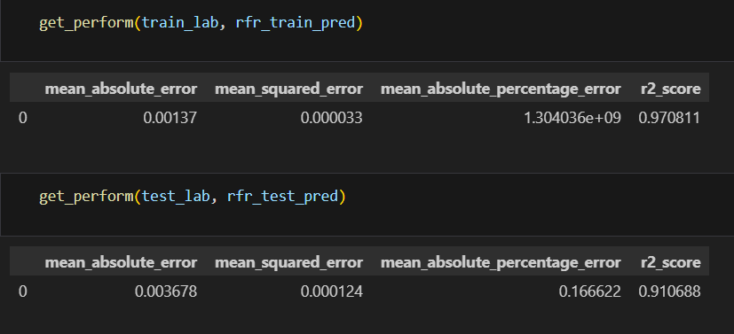
Prediction Modelling
Models Used:
Linear Regression
Random Forest
XG Boost
Gradient Boosting
Decision Tree Regressor
Evaluation:
Performance metrics such as MSE, MAE,R-squared, MAPE
Cross-validation to assess model robustness
Comparison of model accuracies
Best Model Selection
Based on evaluation metrics, the Random Forest model emerged as the best performer due to its superior accuracy in predicting used car prices.

Slide 7
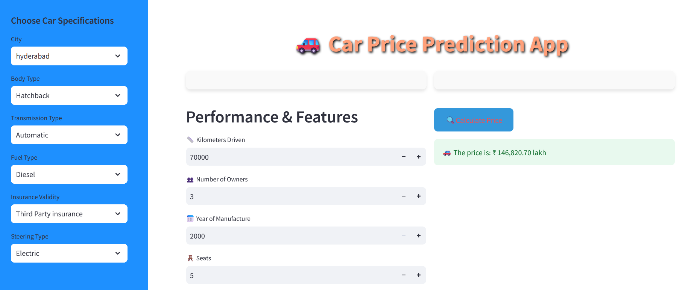
Application Design
Purpose:
Developed a user-friendly web application using Stream-lit to allow users to predict car prices based on selected features.
Features:
Input forms for user data
Integration with the deployed Random Forest model for real-time predictions
Visualizations to enhance user experience

Slide 8
Conclusion
In this project, we successfully developed a model to predict used car prices using different machine learning algorithms.
After comparing several models, Random Forest gave the best results.
We also built a simple web app using Stream-lit, which allows users to easily predict car prices by entering key details.
Future Work
Discuss potential enhancements or additional features that could be implemented to further improve the model’s accuracy or usability of the application.
References
Include information for datasets, libraries, and methodologies used throughout the project.
https://github.com/Syed-Abuthahir-M/Car-Dekho-Price-Prediction

